Slide 1
RUNNING NINJA
Made and presented by
Le Thanh Son

Slide 2
Slidehood.com
OVERVIEW
Brief info about game development
Gameplay and Objectives
Features
Future Ideas
Useful stuff in development

Slide 3

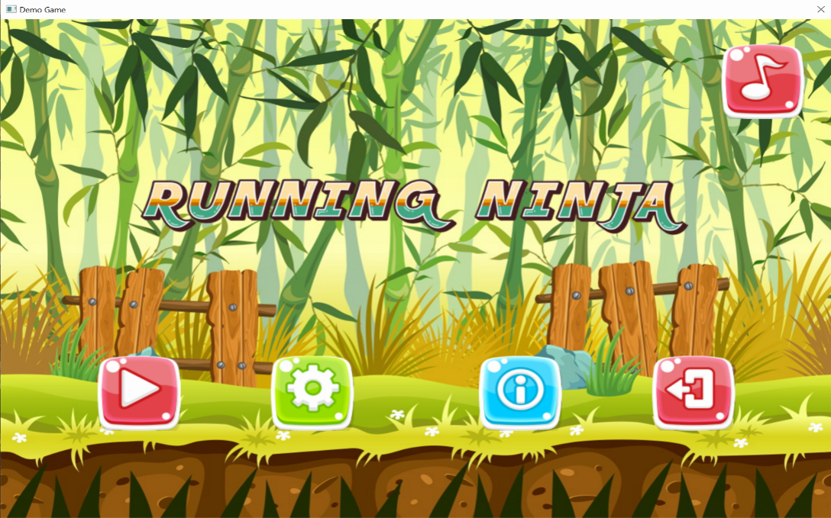
About this game development
Slidehood.com
Windows
2 weeks
Microsoft Visual Studio Express 2015

Slide 4
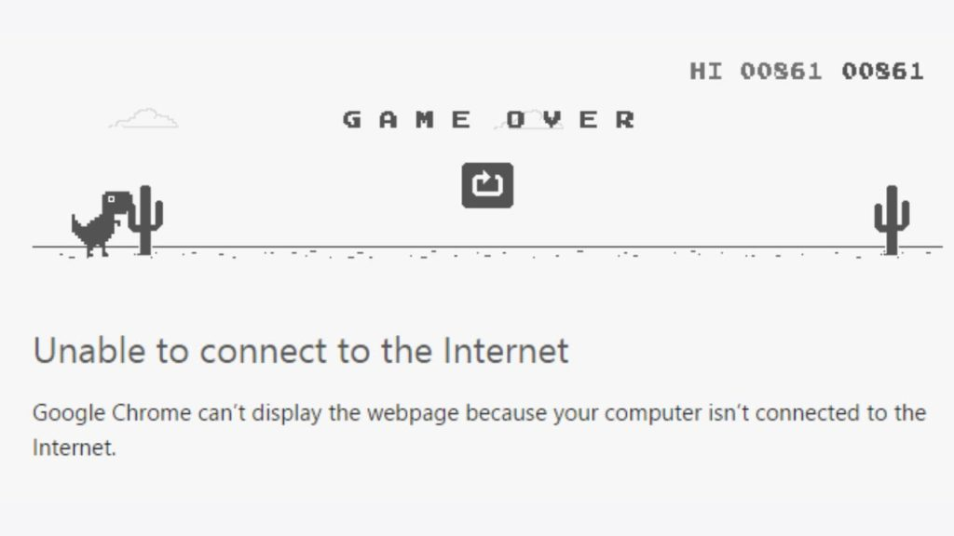
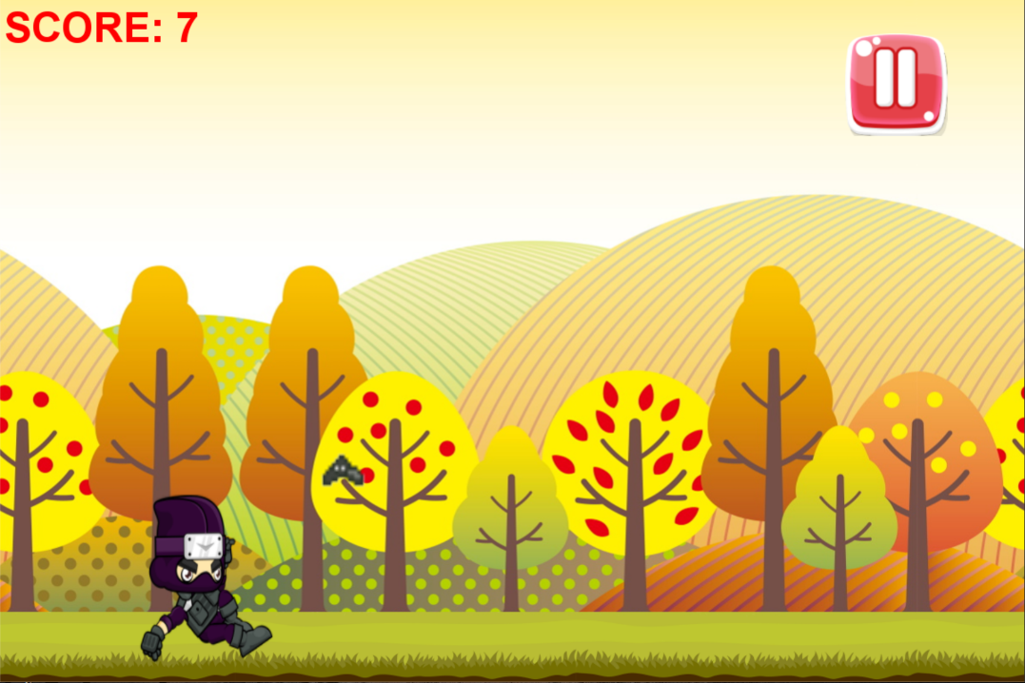
Gameplay
Slidehood.com
+ Inspired by Dino Disconnect Game.
+ Control your character (a ninja) using Up/Down
arrow keys to dodge and pass through all kinds of
Obstacles like spikes, bats ...
+ Pass 1 obstacle -> Get 1 point
+ As you proceed further and in a stage, the game will be harder
and those obstacles become more tricky to dodge. They can
move faster, more variety and sometime have surprise special
movement.
+ The game has no limit. It ends when your character is stopped
by any obstacle.

Slide 5
Objectives
Slidehood.com
Stay alive and score as much as possible. Even though you failed, never give up!
Become satisfied as you get better and better at the game.
And the most important:
HAVE FUN !!

Slide 6
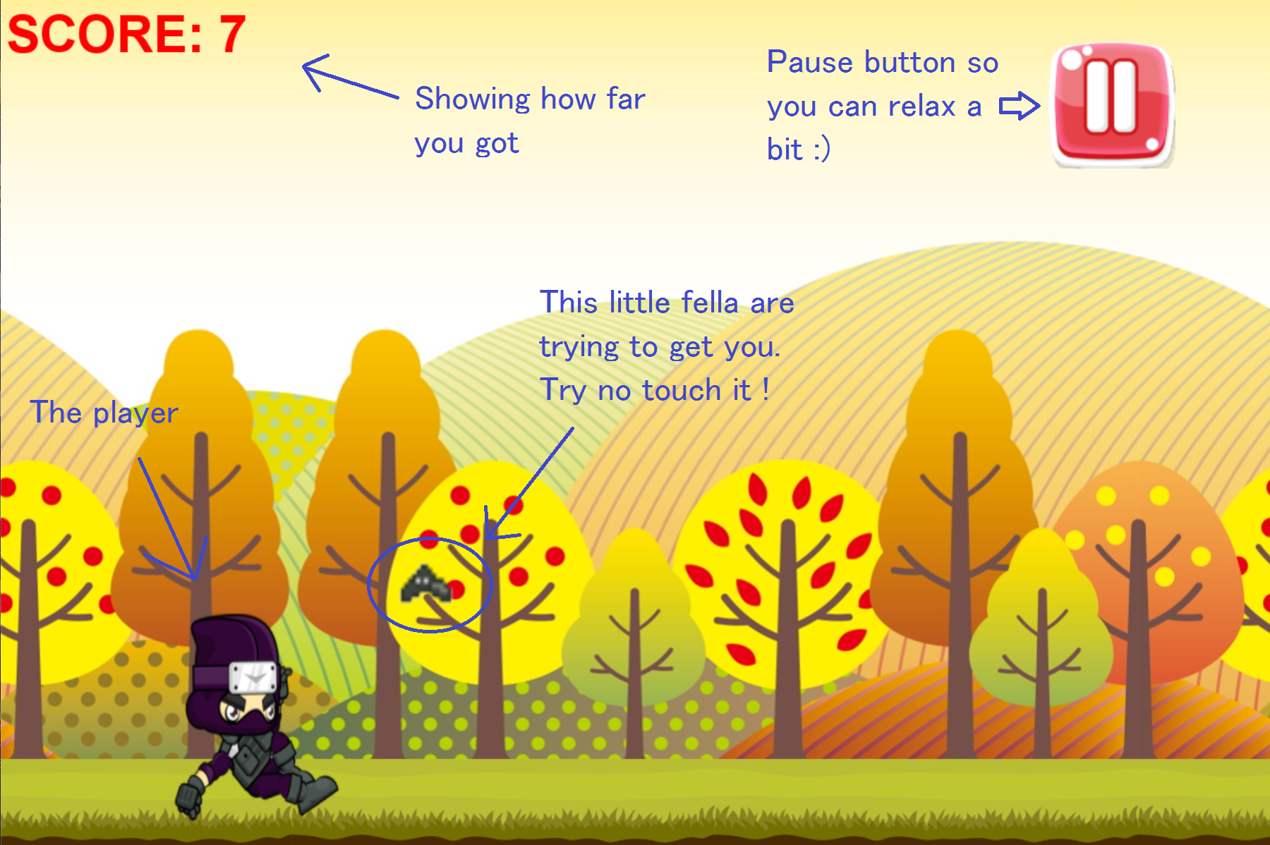

Slide 7
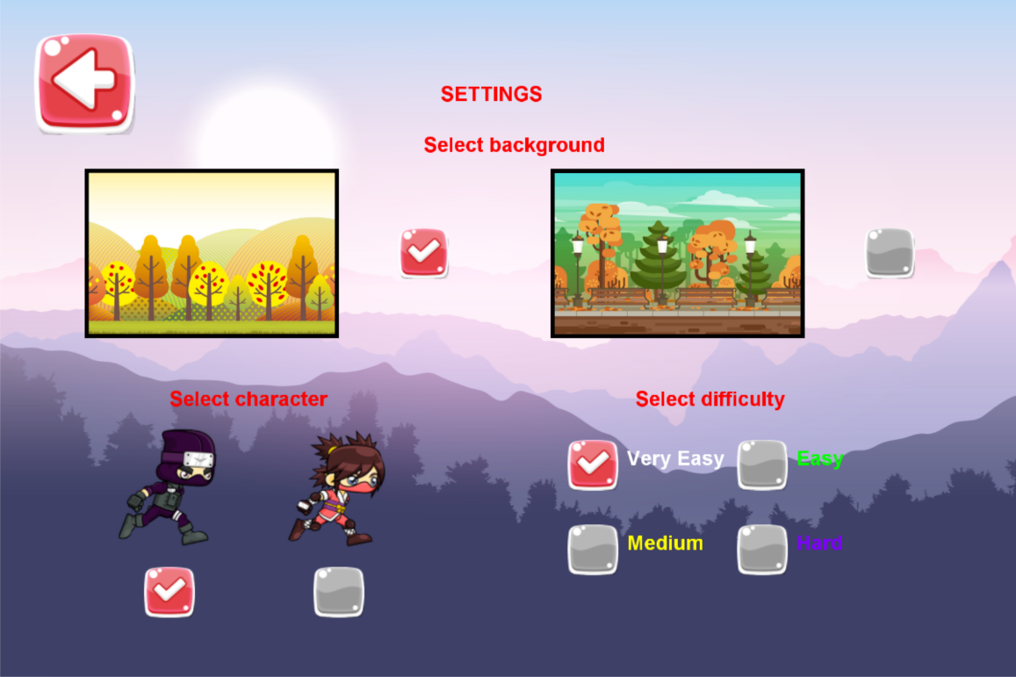
Slidehood.com
Customize your game
+ Change background.
+ Become a male or a female ninja.
+ Challenge yourself with higher game difficulty.
+ Enjoy awesome music or turn it off to focus on your run.

Slide 8
Slidehood.com
Future development ?
Add more challenging obstacles
Improve game performance
Show your high score with friends
Provide more features/services for users
Add unlockable items (backgrounds,
characters, obstacles ...)
Release on many platforms

Slide 9





Some helpful tools and sources in the game development
Slidehood.com

Slide 10

THANKS FOR LISTENING
Slidehood.com

